Slide 2

DESIGN SPRINT 3
Industries

Slide 3
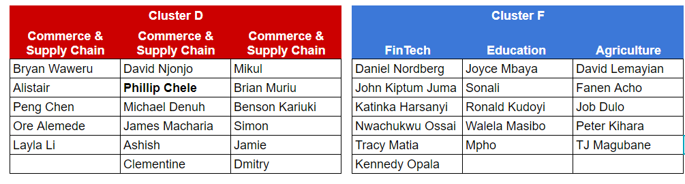
Design Sprint 3 | Team Split
Dmitry

Slide 4



Your Challenge
Iterate quickly identify a problem, propose a solution and validate your idea in as much depth as possible …
A Pressing Problem
A Fitting
Solution
Thorough Validation

Slide 5
Output: Powerpoint presentation (6 minutes in total)
What is the problem? Who does it affect?
Use an issue tree to identify key problem areas and align as a team.
The Problem
Your solution
What’s the best solution you want to propose?
What are key considerations that would make the originally stated problem solvable (financially, technically, practically) through your proposed solution? How far were you able to validate them? What’s your degree of confidence?
Your Validation

Slide 6


Objective: target to clarify 3 metrics during this Design Sprint
Clear identification of the problem
` Robustness of solution & solution/problem fit
Identification of key “show stoppers” and depth of validation

Slide 7
Timetable: September 14 - 17 2020
Monday Sept 14
13:30 - 13:40
Introduction to Design Sprint 3
13:40 - 17:15
Working session part 1
Tuesday Sept 15
13:30-17:15
Working session part 2
Wednesday Sept 16
13:30-17:15
Working session part 3
Thursday Sept 16
9:00 - 10:30
6 min presentation | 3 min Q&A

Slide 8

www.antler.co

Slide 9



THINGS TO THINK ABOUT
What is your target market?
Who is the ideal user of your solution?
What problem does your solution solve for the ideal user?
How big is the market for your solution?
How will you go to market?
How will you tactically reach your ideal users?
How will the ideal users learn about your solution?
How will you commercialize your solution?
What are risks and limitations to your solution?
How much money will it take to roll it out?
Which stakeholders will have to be aligned with your solution?
Will your solution disrupt the current market order?

